Slide 1
PRODIGY
Arcade Quiz Engine
Academic Instructor
Dr. Meirav Taieb-Maimon
By Guy Manzurola
Notes:
Prodigy is a game based learning tool for english grammar

Slide 2
Prodigy is a Game Based E-Learning Tool
What is E-Learning?
Study anytime, at your own pace.
Delivered through digital devices (computer, mobiles etc.)
Cost-effective (no humans involved in teaching, provides automatic feedback)
Accessible

Slide 3

The Problem: Keeping Learners Motivated
It has always been one of the teacher’s primary roles to motivate students through the learning process.
Motives of a student:
Connection with the learnt
material (rare)
Extrinsic rewards
Intrinsic goals
Fear
Pleasing others
(Prensky, 2002)
Notes:
Problem:
Educators are mainly concerned with getting the material across, to instruct.
Motivation relies on:
-connection with the learnt material (rare)
-extrinsic rewards (get score over x, I’ll buy you a Lego set)
-Intrinsic goals (I want to be able to do Y, so I learn more)
-Fear (If I don’t do it, Z will happen)
-Pleasing others (Teacher will like me if I do this)

Slide 4
The Problem: Who is the User?
Most existing e-learning solutions focus on the needs of educators rather than fulfilling the needs of the learners themselves.
(Pivec, 2007), (McGinnis, Bustard, Black, & Charles, 2008), (Jong, Shang, Lee, & Law, 2006).
This leaves the learners to find the necessary motivation to study the content themselves.

Slide 5
Why Not Have Some Fun?
It is known that a brain enjoying itself functions more efficiently.
In other words, if we enjoy learning, we learn better.
(Bisso and Luckner, Journal of Experimental Education, 9,2, 1996, pp 109-110.)
(Rose and Nicholl, Accelerated Leaning for the 21st Century, 1998, p. 30.)
(Dr. Frank Moretti, Columbia Teachers College.)
(Knotts and Keys, Simulation and Gaming, 28:4 1997 p. 378)
Notes:
Goal:
Motivating students of esl through various exercises used to practice the structure of the english language (a measure – high completion rate)

Slide 6

Introducing Fun in Learning: A Lesson from Game Design
A game designer designs a game with the primary goal of keeping the user motivated.
“keep users engaged. Keep players coming back, day after day, so that the person feels he has gotten value for his money.” (Prensky, 2002)
http://www.thefuntheory.com/
Notes:
Solution: Games.
The game designer’s main objective:
“keep users engaged. Keep players coming back, day after day, so that the person feels he has gotten value for his money.

Slide 7
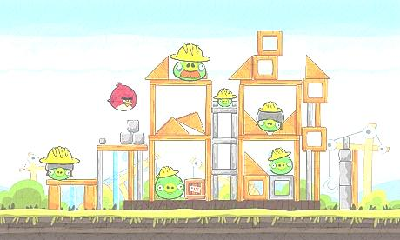
What Makes Things Fun To Learn?
Characteristics of a Good Game (Malone, 1980):
Challenge
Goals (performance feedback)
Uncertain Outcomes (multiple level goals, variable difficulty levels, hidden information, randomness)
Self Esteem (keep it high)
Fantasy
Extrinsic Fantasy
Intrinsic Fantasy
Curiosity
Sensory (sound and graphics)
Cognitive (surprising and constructive feedback)
Notes:
Learning and games:
Implement a learning tool using principles from game design.

Slide 8
Heuristics for Creating Fun in Games (Federoff, 2002)
Element | Guideline
Game Interface | A player should always be able to identify their score/status in the game
Game Interface | Use sound to provide meaningful feedback
Game Interface | Provide means for error prevention and recovery through the use of warning messages
Game Interface | Players should be able to save games in different states
Game Mechanics | Feedback should be given immediately to display user control
Game Play | There should be a clear overriding goal of the game presented early
Game Play | There should be variable difficulty level
Game Play | There should be multiple goals on each level
Game Play | Game play should be balanced so that there is no definite way to win
Game Play | The game should give hints, but not too many
Game Play | The game should give rewards
Game Play | There must not be any single optimal winning strategy
Game Play | Design for multiple paths through the game

Slide 9
Evaluating Existing Solutions (1)
We looked at three groups of solutions:
Learning management systems (Moodle, Quizlet).
English learning games (Alien Language, Mingoville and more)
Language Learning Software (Rosetta Stone)
Notes:
---Theoretical Background – fun in games / software ---
User: Student.
Most solutions are concerned with the educator as their user (learning management software)
The teacher’s value is greater than that of the student

Slide 10
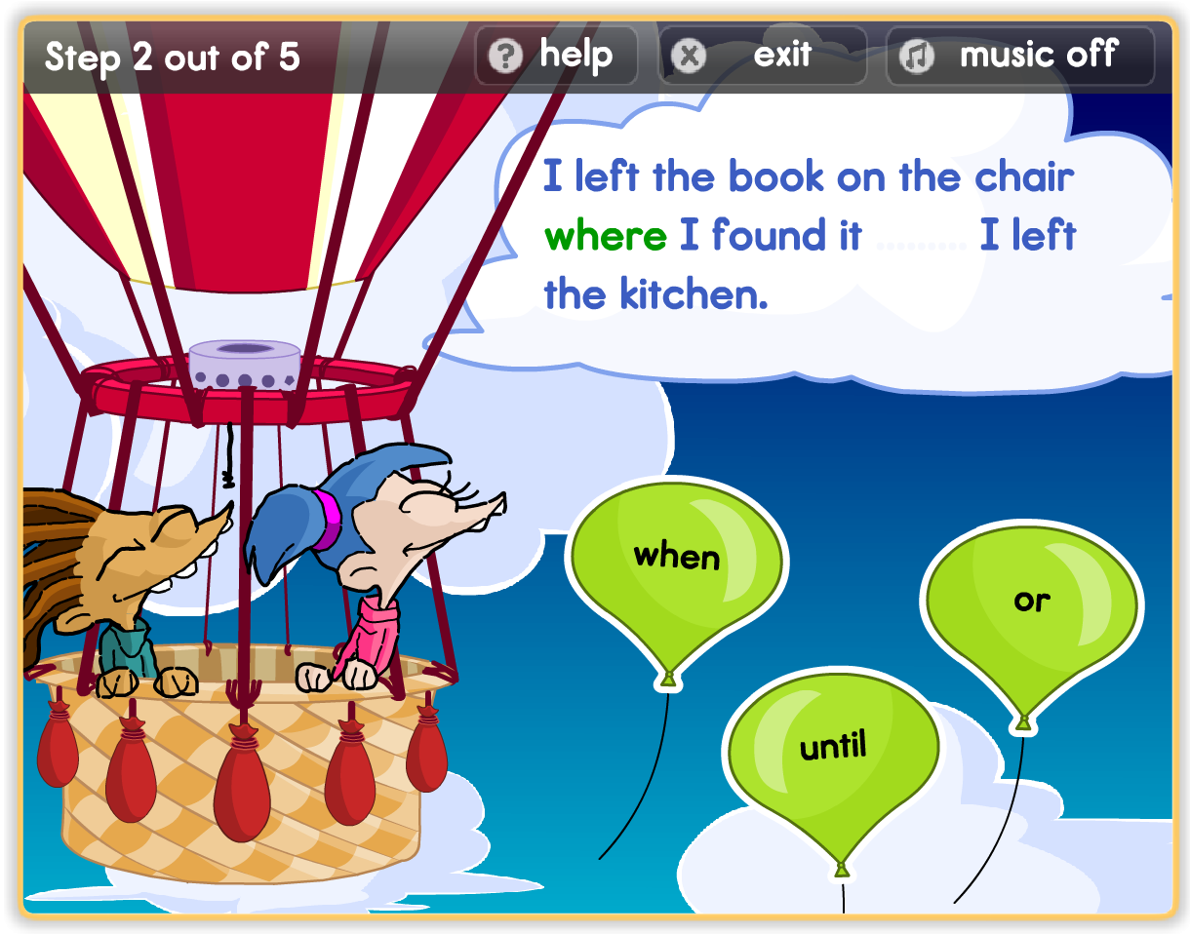
Evaluating Existing Solutions (1.1) Example - BBC’s The Magic Key - Popup

Slide 11
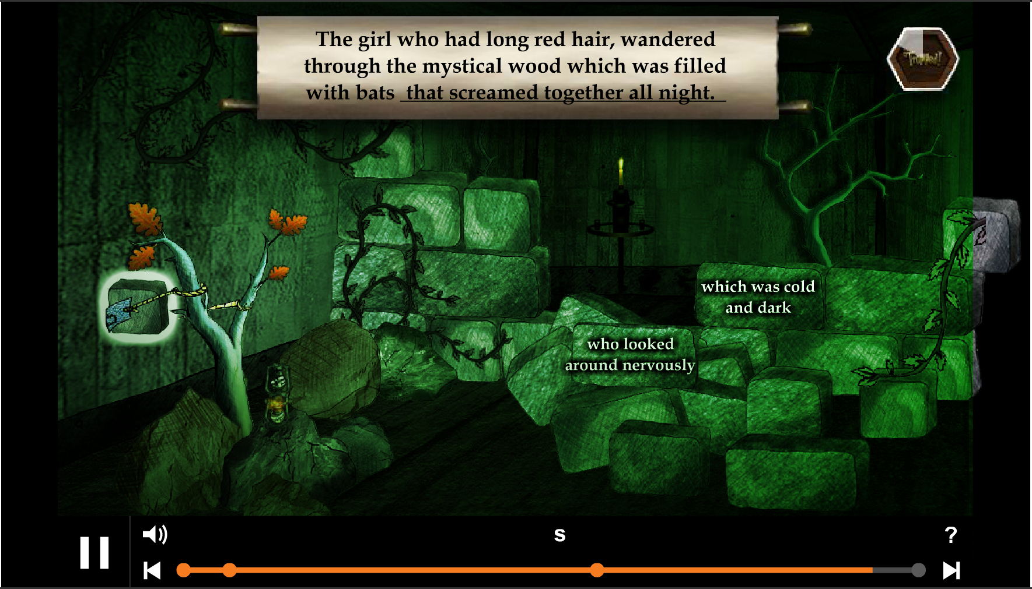
Evaluating Existing Solutions (1.2) Example - BBC’s The Magic Key – Trapped

Slide 12
Evaluating Existing Solutions (2)
We want to determine the existence of a solution that will allow us to:
Immerse user in gameplay environment (evaluated in part by Malone’s and Federoff’s compiled heuristics)
Create a question format that will allow users to solve questions by assembling an answer from existing dynamic choices.
Provide feedback on theoretically every possible permutation of answer.

Slide 13
Evaluating Solutions (3)
Guideline | Games |  |  |  |  | LLS | LMS |  | Prodigy
 | Alien Language | BBC’s The Magic Key | Mingoville | Monkey Puzzles | Academy Island | Rosetta Stone | Quizlet | Moodle
In game score/status | V | V | V | V | V | V | V | X | V
Audio feedback | V | V | V | V | V | V | V | X | ?
Error prevention | X | X | X | X | X | V | X | V | V
Save state | X | X | V | X | V | V | X | X | V
Immediate feedback | V | V | V | V | V | V | V | X | V
Clear goal | V | V | V | V | V | V | X | X | V
Variable difficulty level | X | X | X | X | X | X | X | X | V
Multiple level goals | X | X | V | V | V | V | X | X | V
More than one way to win | X | X | X | X | X | X | X | X | ?
Give few hints | V | V | V | V | V | V | V | V | V
Give rewards | V | V | V | V | V | X | X | X | V
No optimal strategy | X | X | X | X | x | X | X | X | V
Multiple paths through game | X | X | V | X | V | X | X | X | ?
Socialization | X | X | V | V | V | V | V | V | V
Multiplayer | X | X | V | X |  | X | V | X | X
Notes:
We selected a few basic principles as the starting baseline, and we shall evaluate current solutions based on them.

Slide 14
Goal
The goal of Prodigy then, is to implement a tool that would make the learning process engaging and motivating for the student.

Slide 15












Technologies and Tools
Notes:
Requirements from solution and table of comparison

Slide 16
Bottom Tier - MySQL
Feature | Oracle 11g XE | MS SQL Server Express | MySQL Community Edition
CPU usage count | 1 | 1 | Unlimited
License | Free | Free | Free
Support | + | + | -
GUI Administration | + | + | Workbench
Procedures | + | + | +
Functions | + | + | +
Triggers | + | + | +
Windows | + | + | +
Mac OSX | + | - | +
Linux | + | - | +
Unix | + | - | +

Slide 17
Middle Tier - Java
Feature | Jetty | IIS | Tomcat
License | Free | With Licensed Windows System | Free
Web Socket | + | + | +
REST | + | + | +
Servlet Container | + | - | +
Support | Medium | High | High

Slide 18
Client Tier – HTML5
Data Interchange:
JavaScript Object
Notation
Communication
Protocol:
WebSocket

Slide 19
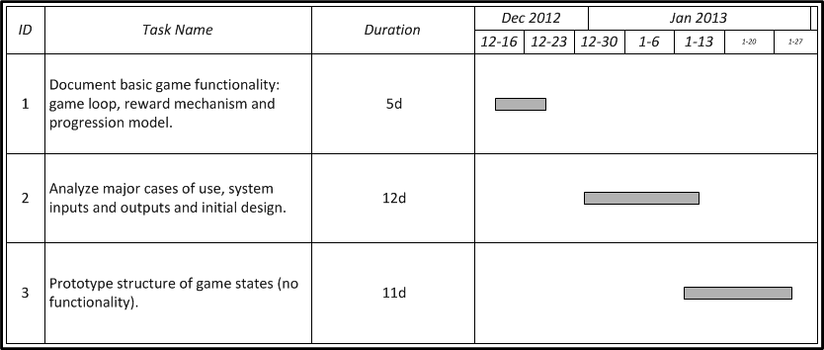
Work Plan

Slide 20
FIN
Good Luck !

